Slide 1


大数据•大情报——第四届竞争情报国际峰会
2014-10-24--2014-10-26 北京
The Future of the Global Market
~from the viewpoint of Business Intelligence and Big Data~
Juro Nakagawa
Specially Appointed Professor, Nagoya City University
22nd Century Institute
President, Business Intelligence Society of Japan

Slide 2
Topics
The Age of the Information Industry Revolution
The Age of the Global Market
Origins of the Information Industry Revolution
The Global Age
Conclusion

Slide 3

Introduction
The world has been changing very rapidly due to the globalization of its economy and the development of ICT.
The rise of the West, as a result of the industrial revolution, is being repeated in Asia.
Addressing three important questions:
To what extent will the world change as a result of the economic development of the BRICS countries (Brazil, Russia, India, China, and South Africa) and other developing countries in the 21st and the 22nd centuries?
What impact will technological change have on the world economy?
How should Japan respond to these changes?

Slide 4
The Age of the Information Industry Revolution
10,000 years ago : shift from the life based on hunting and gathering to the agrarian society
The latter half of the 18th century: the Industrial Revolution
The middle of the 20th century: the Information Revolution
The 21st century: the Information and Knowledge Revolution
Today, information and knowledge have become the driving engines of the age of the Information Industry Revolution.

Slide 5
The Age of the Global Market
Expansion of the market economies since the fall of the Berlin Wall in 1989
China’s embrace of the market economy a decade earlier
How deeply will the Globalized Market and Information Society influence the world in the 21st and 22nd centuries?
We should anticipate widespread upheaval, and so we must establish a strategy to cope with rapid change in the future.

Slide 6
Origins of the Information Industry Revolution
The Information Age, which started in the mid-20th century, has entered the 21st century, during which the Information Industry Revolution will change the entire world through the Internet and “big data,” the large, complex data sets which are currently being created around the world.
The world has been changed dramatically due to the information wave.
The corporations in the big data age can originate and add new values by big data. (*1)
Power in the Agricultural Age 10,000 years ago was based on land, and that in the Industrial Age was based on capital. Information has been the source of power in the Information Age, since the middle of the 20th century, and knowledge has become an additional source of power in the Knowledge Information age of the 21st century.
By the 22nd century, big data will become the primary source of power in society.
Who control information will control the world.
*1) Mr. Joichi Itoh, Director of the MIT Media Lab.

Slide 7
The Global Age (1)
Communist countries have shifted to market economies, accelerating globalization of world economy since 1989.
At the end of the 1990s and during the early 2000s, an Information Society, led by ICT and the Internet, has emerged.
The terrorist attack against the United States on September 11, 2001 and destruction of the World Trade Center in New York, which led to the occupations of Afghanistan and Iraq by the US, have changed the world.
The US subprime loan crisis in 2007, and Lehman Shock in September 2008, triggered a world financial and banking crisis.
The recent sovereign debt crisis in Greece and Spain has weakened the euro and severely damaged the EU economy.
In the meantime, the BRICS countries and other developing countries have made great progress in economic development. The Next Four countries (Korea, Indonesia, Mexico and Turkey) will soon emulate the BRICS, and the weakest members of the G20 will follow.

Slide 8
The Global Age (2)
The Next 11, which includes Korea, Indonesia, Vietnam, the Philippines, Bangladesh, Pakistan, Iran, Egypt, Turkey, Nigeria and Mexico, have been steadily developing and will emerge as economic powers in the 21st century. Due to ICT and the big data revolution, these newly developing countries will play an important role in the world economy.
The G20 countries have continued to show rapid economic progress.
The ASEAN 10 countries, which include the Mekong River states of Thailand, Vietnam, Cambodia, Laos, and Myanmar; the SCO states, which include China, Russia, Tajikistan, Kyrgyzstan, Kazakhstan, and Uzbekistan; and Africa, which consists of 54 countries, are all projected to experience rapid growth between the 2020s and 2030s.
The EU’s Asia–Europe Meeting (ASEM), which includes 41 member countries, and the U.S.-negotiated Trans-Pacific Partnership (TPP) are aimed at tapping into the large, developing Asian market of the 21st century.

Slide 9
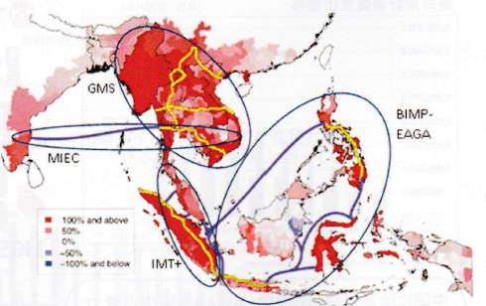
AEC (ASEAN Economic Community)
MIEC, GMS, BIMP, EAGA
Source: MGSSI document

Slide 10
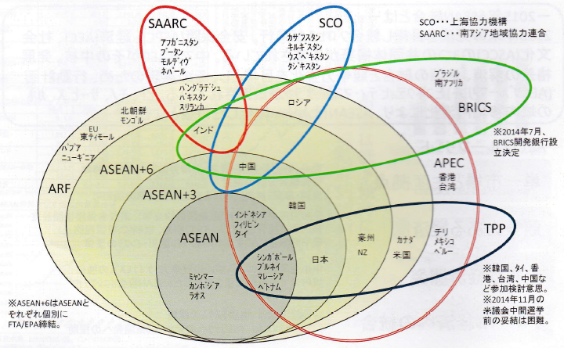
Ａｌｌｉａｎｃｅ Network in Asia-Pacific region
SAARC, SCO, BRICs, APEC, TPP
Source: MGSSI document

Slide 11
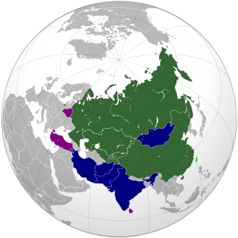
Shanghai Cooperation Organisation

Slide 12
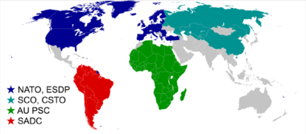
Ｃｕｒｒｅｎｔ Ｍａｊｏｒ Ｍｉｌｉｔａｒｙ Ａｌｌｉａｎｃｅ

Slide 13
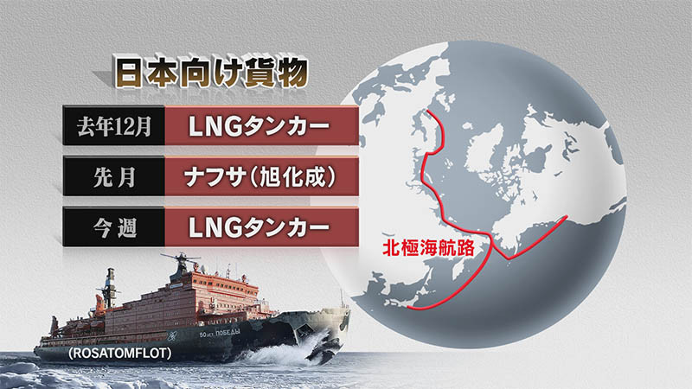
Arctic Ocean (1)

Slide 14
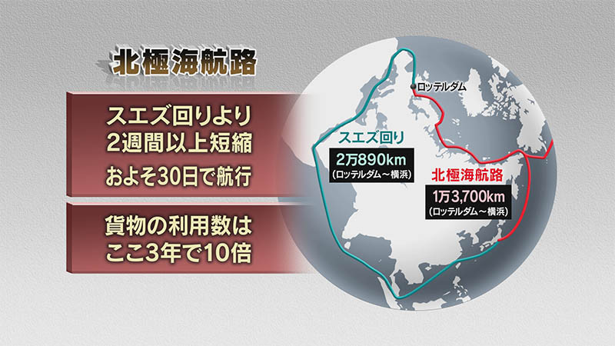
Arctic Ocean (2)

Slide 15
Conclusion
The European and American financial systems went through a severe crisis
The US government’s recent NSA Internet spying scandal has also been criticized worldwide from the standpoint of governance, human rights, and ethics.
Japan must connect ASEAN in East Asia and the SCO in Central Asia, and establish a broadened Asian community
It is high time for united Asia

Slide 16
Main Reference
1）Gekidosuru Global Keieisenryaku. rapidly changing global business strategy, Azumi Toshimasa,Nikkan Kogyo Shimbunsha,2009.
2) Global Marketing Nyumon, An Introduction to Global Marketing, Aihara Osamu, Shima Tadashi and others. Nihon Keizai Shimbunsha, 2009.
3）Higashi Asia kyodotai to Nihonno Senryaku,The East Asian Community and Strategy of Japan, Eiichi Shindo, Juro Nakagawa and others, Obirin University Press, 2001.
4） Chishiki Joho Senryaku, Knowledge Information Strategy, Akira Ishikawa and Juro Nakagawa, editors and writers, Zeimu Keiri Kyokai，2009.
5） TaichuSenryaku，Strategy against China，Taisuke Kondo，Kodan-sha,2013．
6) Chugokujin to Indojin，Chinese and Indians，Takeshi Nakajima, Kodansha, 2013．
7） Tsuginaru Keizaitaikoku，The Growth Map: Economic Opportunity in the BRICs and Beyond，Jim O‘Neill, Diamond sha,2012．
8） The Mekon,2020nen Sekai no Kojo e, The Mekon to the New World Factories、Nikkei Business, May13, 2013
9）Africa-Syakunetsu no 10 okunin shijo、heated Africa with 1 billion population Market, Nikkei Business, May 27, 2013．
10）BIG DATA no Shotai, BIG DATA , A Revolution That will Transform How We Live, Work and Think. DATA is NEW OIL, Victor Mayer
Schonberger, Kenneth Cukier, Kodansha, 2013．
11）Big Data no Shogeki, The shock of Big Data, Makoto Shirota, Toyo Keizai, 2012．
12）Big Data no Hasha tachi, Great Champions of Big Data, Miwa Kaifu, Kodansha, 2013．
13）Chi no Gyakuten, An Inversion of Wisdom, Mayumi Yoshinari, NHK Publishing, 2013.
14）Keizai to Jinrui no 10000 nenshi kara 21seiki sekaiwo kanngaeru, La Prosperite du Vice: Une introduction (inquiete) a l’economie,
Daniel Cohen. Sakuhinsha, 2013．
15）2100 nenno Kagaku raifu, Physics of the Future, Michio Kaku, NHK Publishing, 2011．
16）100 nen Yosoku, The Next 100 years – a Forecast for the 21st Century, George Friedman, Hayakawa Shobo, 2001．
17）2052, Jorgen Landers, Nikkei BP, 2012．
18）2050 nen no Sekaichizu, A World Map in 2050, Laurence C.Smith, NHK Publishing, 2013.
19）2050 nen no Sekai, Megachange、The World in 2050、The Economist, Bungei Shunjusha、2012．
20）2030 nen Sekaiwa Kou kawaru, Global Trends 2030, National Intelligence Council, Kodansha, 2013
21） Gekido yosoku, The Next Decade、George Friedman, Hayakawa Shobo、2011．
22） Bureikuauto neishonzu, Breakout Nations, Lucia Sharma, Hayakawa Shobo, 2013.
23） Tsugino Kyodai Torendo, The Next Mega Trend, Takashi Asai, PHP, 2013.
24） Competing for the future, Gary Hamel & others, Harvard BS Press, 1994．
25） Seeing What's Next, Clayton Christensen, Harvard BS Press, 2004．
26) Foreign Affairs Report No.6, 2013
27） Nihon Keizai Shimbun (Japan Economic Journal ), September 12, 2014．
28） Asahi Shimbun ( Asahi News Paper), September 13, 2014．
29) Nihon Keizai Shimbun (Japanese Economic Journal), September 13, 2014.
30) My Navi News, July10, 2014.

